Slide 1

Identifying Low-Risk Aircraft for Strategic business GROWTH.

Slide 2

AGENDA
Introduction
Business context
Data and Process Steps
Recommendations
Evaluation and Future Improvements
Contact information

Slide 3

INTRODUCTION

Slide 4

Background: Our company is diversifying by expanding into the aviation industry, with an aim of operating aircraft for both commercial and private enterprises.
Objective: Identify the lowest-risk aircraft based on Aircraft damage, Number of Engines of the aircraft, Model of the aircraft among other factors .
Outcome: Provide data-driven recommendations that will guide the head of aviation division in the process of selecting the best aircraft for our company.

Slide 5

Business context

Slide 6
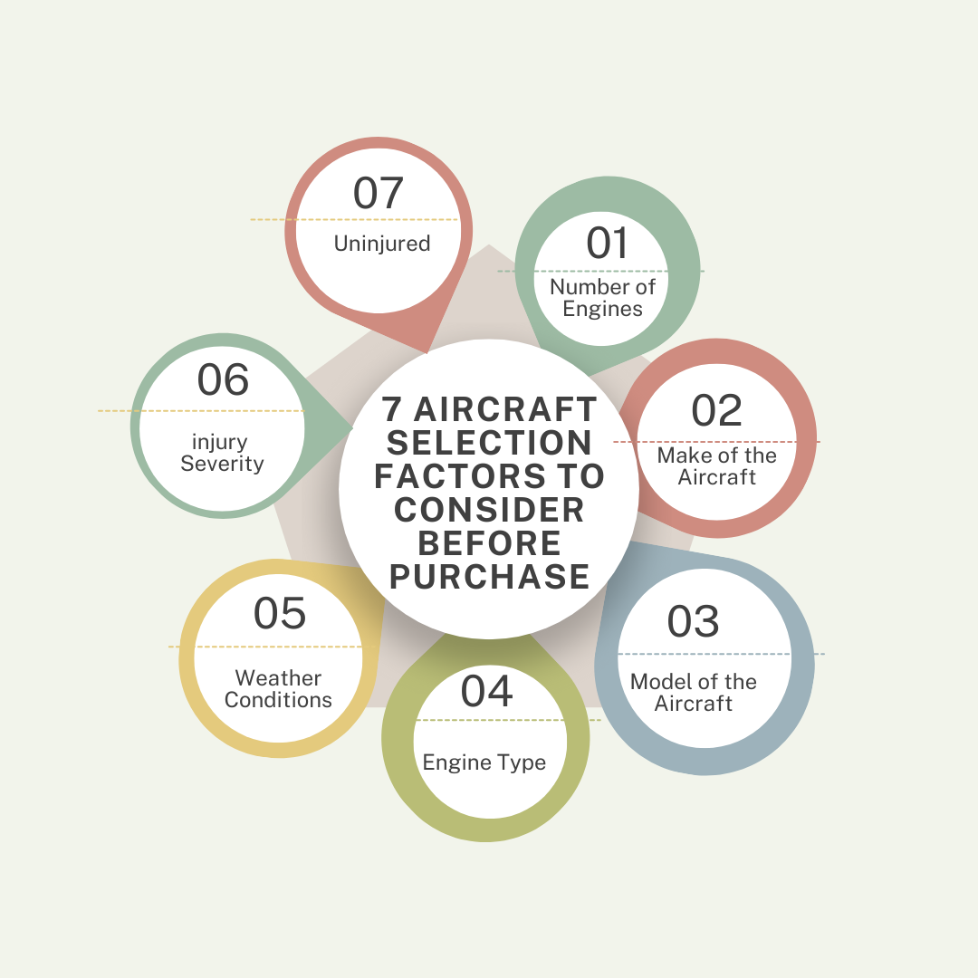
7 factors to consider before purchasing an aircraft
The most important factors to consider when purchasing an aircraft include:
Number of Engines
Make of the Aircraft
Model of the Aircraft
Engine Type
Weather Conditions
Injury Severity.
Uninjured

Slide 7

Data and the process steps

Slide 8

A DATA DRIVEN APPROACH
In this project I made use of aviation accident data from the National Transportation Safety Board (1962–2023), we will analyze risks, identify trends, and provide actionable recommendations.
The Aviation data used for this analysis can be accessed using the link below: https://www.kaggle.com/datasets/khsamaha/aviation-accident-database-synopses
We used numpy, pandas and matplot libraries for our analysis
Approach: ✔ Clean and preprocess data to handle missing values ✔ Aggregate and visualize key risk factors ✔ Derive three concrete business recommendations ✔ Present findings using clear, impactful visualizations

Slide 9

Data cleaning
We handled the below when doing data cleaning;
Understanding the dataset
Removal of duplicates
Dropping unwanted Columns
Handling missing data

Slide 10

DATA analysis
Conducted an analysis by first examining categorical data:
Identified unique top values
Identified unique bottom values
Performed a numerical data summary using the describe function
DATA VISUALIZATION
We have created visualizations to enhance data understanding and simplify analysis.
These visualizations help us to identify trends, patterns, and major insights in the dataset.
Key Visualizations:
📊 Bar Graph – Effective comparison of categorical data
📈 Line Chart – Shows trends of a given dataset over time
📉 Histogram – Displays the distribution of data.
⚫ Scatter Plot – Shows the relationships that exist between variables

Slide 11
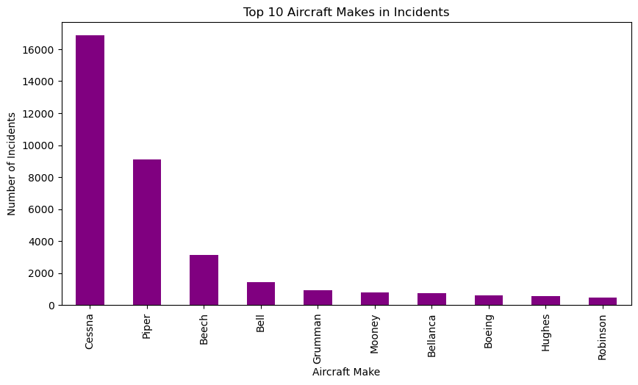
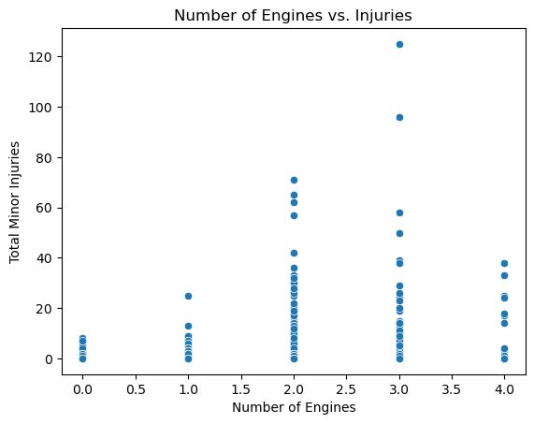
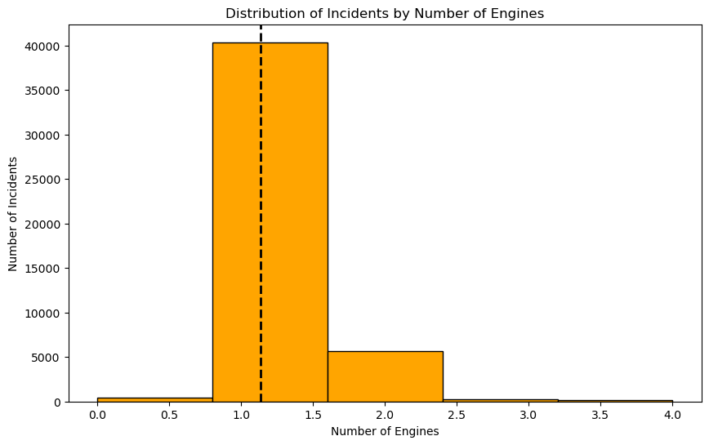
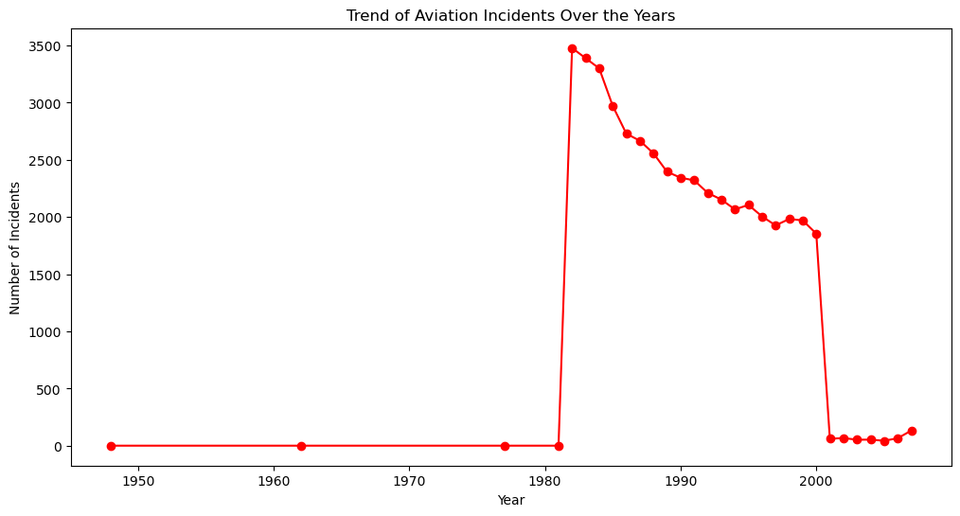

Slide 12

RECOMMENDATIONS

Slide 13

The data shows that Cessna and Piper aircraft have the highest number of incidents. The operators and manufacturers of these models should enhance safety measures, provide better training for pilots and maintenance protocols.
The scatter plot indicates a correlation between the number of engines and minor injuries. The Aircraft with more engines might experience different safety risks, requiring further analysis to optimize engine design and safety features.
Since incidents are more frequent in aircraft with fewer number of engines, companies should consider investing in models with proven safety records to minimize operational risks and enhance passenger safety.

Slide 14

Evaluation and Future Improvements

Slide 15
FUTURE IMPROVEMENTS
Examine occurrence patterns to raise the bar for aviation safety, paying particular attention to high-risk models and manufactures.
To better prepare pilots for managing emergency scenarios and a range of weather conditions, implement customized training programs.
To lower mechanical failures and mishaps, promote the use of safer aircraft types and make sure they receive routine maintenance.

Slide 16

THANK YOU
Myrajoy Kiganane
Myrajoy.Kiganane@student.moringaschool.com

